Slide 1


A rare genetic disorder models human lupus-like disease
Rose Hodgson
4th year DPhil Student - Cornall and Bull groups
Notes:
My name is Rose Hodgson, I’m a Dphil student in Richard Cornall’s and Katherine Bull’s labs and my Dphil explores the genetic basis of human autoimmune disease.

Slide 2
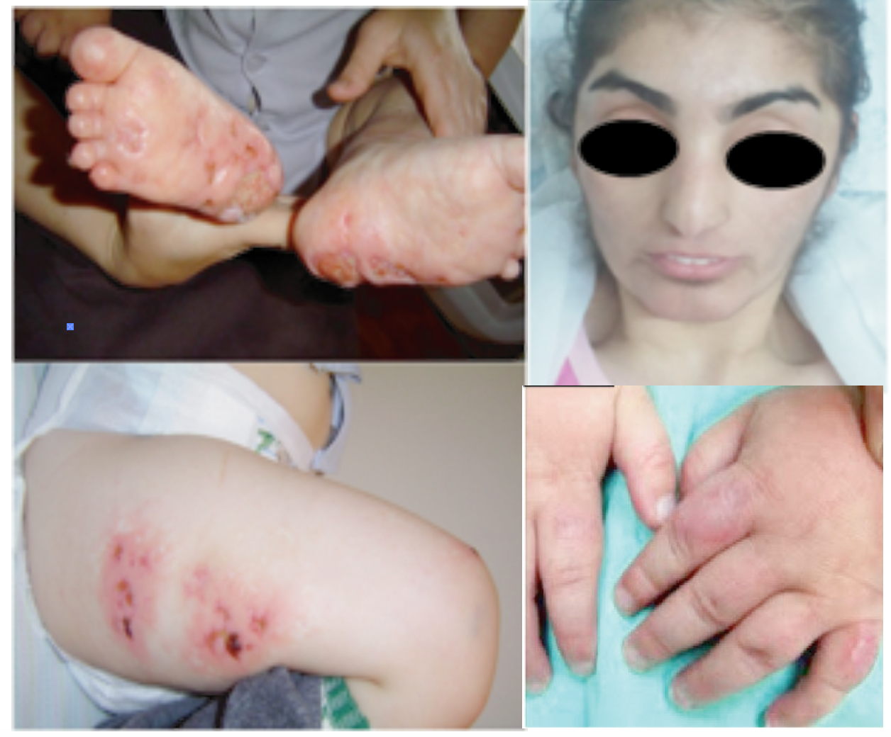
Prolidase deficiency is associated with autoimmune disease in mice – and humans
Butbul Aviel et al. Pediatric Rheumatology 2012
Notes:
3i’s programme- multiinstiutional pipeline that aimed to immunophenotyped over 500 KO mouse lines created by the Sanger to look at the effect of individual genes on immune function
The Cornall and Bull labs provided the anti-nuclear antibody serum screening, ANAs are a classic hallmark in both mice and human
The PepdKO mouse line tested positive for ANAs, indicating that prolidase may play a role in immune function
What really caught our attention is the syndrome seen in prolidase deficient patients, who have a wide range of symptoms including lower limb skin ulcerations, recurrent respiratory and skin infections, and a subset of these patients are diagnosed with SLE, with many screened positive for ANAs

Slide 3
Pepd^{-/-} mice have an activated T cell phenotype
CD4 subsets
CD8 subsets
CD4 subsets
CD8 subsets
Data pooled from 4 independent experiments (n=3-5)
Notes:
Translating to increased numbers of CD4 effectors, but not the other subsets

Slide 4
Pepd^{-/-} mice have an activated T cell phenotype
CD4 subsets
CD8 subsets
CD4 subsets
CD8 subsets
CD4 subsets
CD8 subsets
Data pooled from 4 independent experiments (n=3-5)
Notes:
To first look into the phenotype of PepdKO mice using flow cytometry, showed they have enlarged proportions of CD4 CD44hi effectors and FoxP3+ T regulatory populations, as well as decrease in CD8 central memory and trend increase in CD8 effector memory populations
Using mixed bone marrow chimeras, we have shown that the T cell phenotypeis cell intrinsic as you can see by the specific increase in activated CD4 and Treg populations and CD8 effectors over the baseline subsets
Translating to increased numbers of CD4 effectors, but not the other subsets

Slide 5
The T cell phenotype is intrinsic in mixed chimeras
Data pooled from 3 independent experiments (n=5)

Slide 6
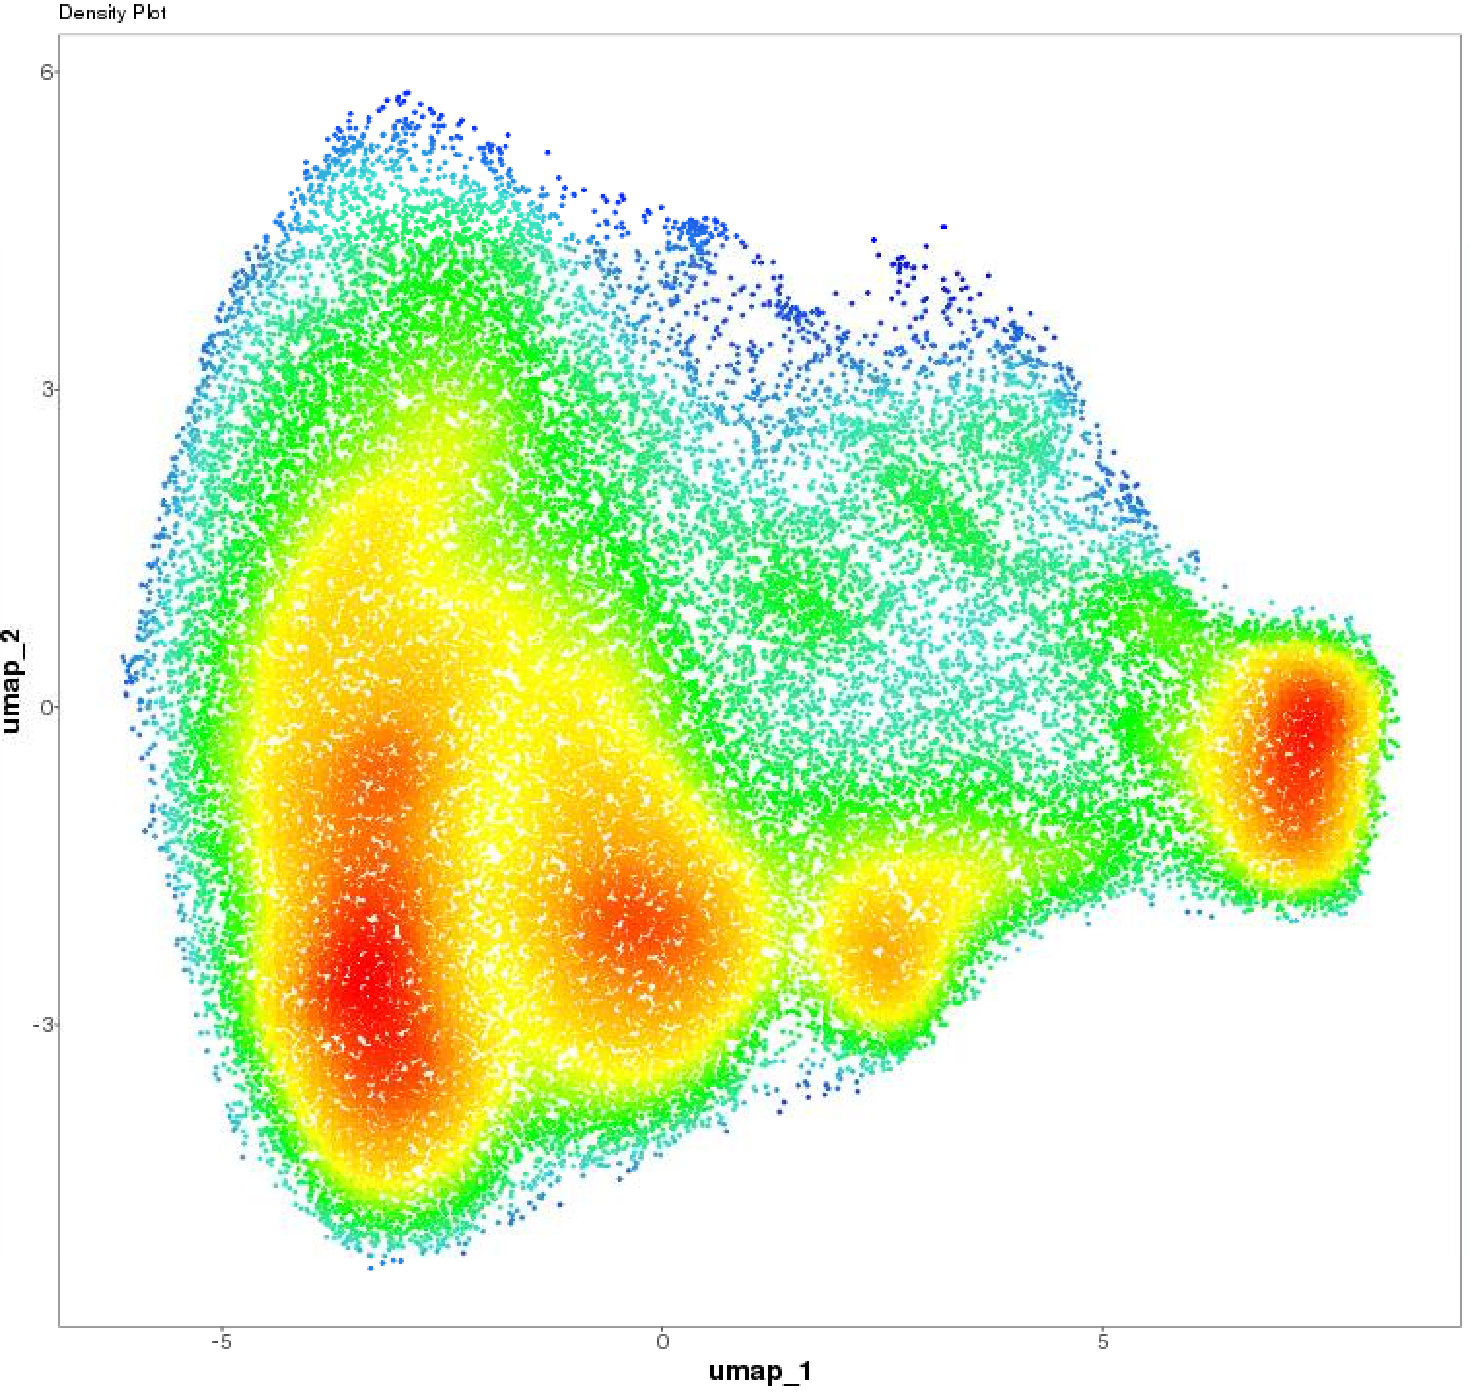
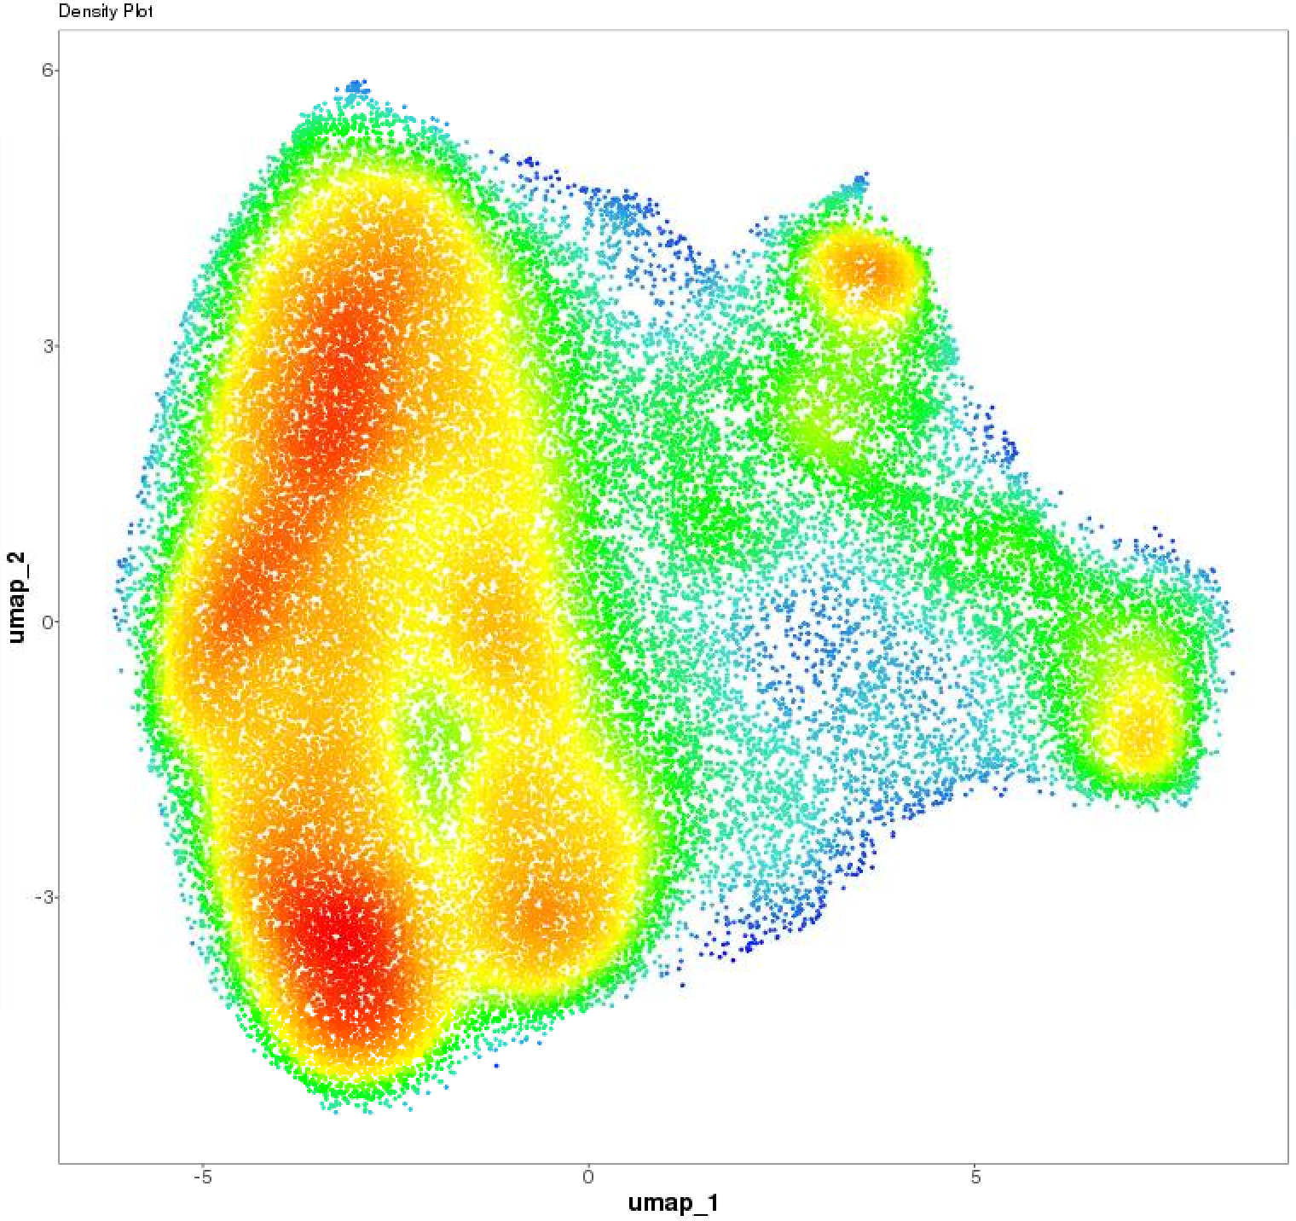
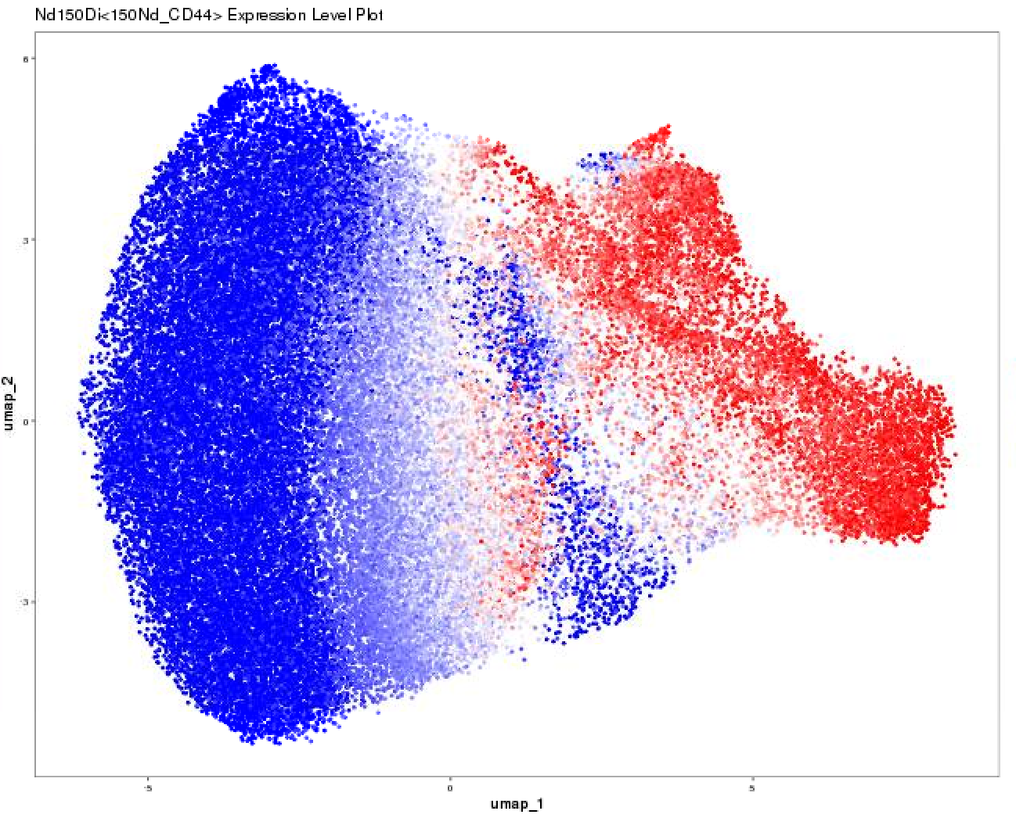
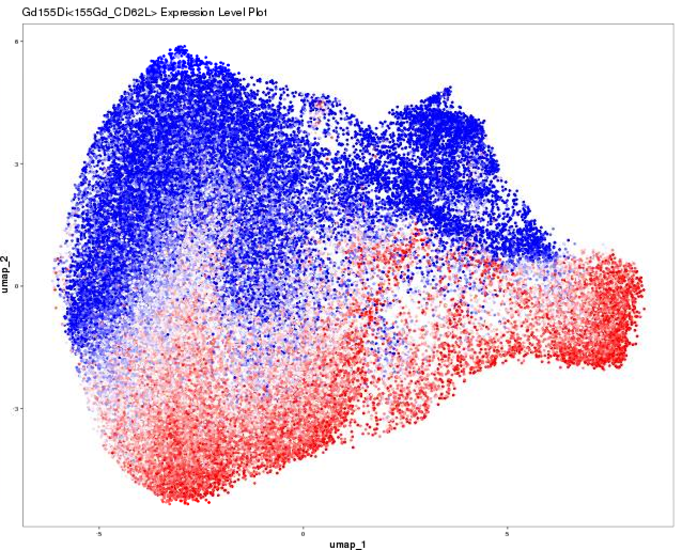
Pepd loss is associated with reduced CD8 central memory
Pepd^{+/+}
Pepd^{-/-}
CD44
***
*
CD62L
*
Proliferating CEM
Proliferating CD8^{lo} naïve
Proliferating effector
CXCR3⁺ CD62L^{lo}
CD69⁺ effectors
PD1⁺ CD69⁺ Effectors
Naïve Ly6C⁺ Bcl2⁺
Ly6C⁺ CD44^{lo} CD62L⁻
Naïve CD5⁺ CD127⁺
Naïve CD5^{lo} CD127⁺
CD8^{lo}
CD8^{lo}
I-A/I-E⁺ non CD8
Ly6C^{hi} CXCR4⁺ CEM
Ly6C^{hi} Effector memory
FlowSOM clustering k=15
Notes:
Cytof analysis of the CD8 T cell subsets confirmed the direction of the activated signature we have seen, firstly you can see by umap that pepdKO cells seem to cluster more densly towards the CD44hi part, where WT cells towards the CD44hi CD62L+ part, suggesting a more naïve signature. When I used automatic clustering approaches such as FlowSOM to pull out these differences, there was a trend towards increased proliferating effector (12) and significantly reduced naïve/central memory populations and Ly6Chi CXCR4 CEM (10&14).

Slide 7
CyTOF analysis indicates Pepd^{-/-} CD4 and CD8 T cells have an altered surface phenotype
CD62L
CD44
Ly6C
PD-1
CD62L
CD44
CD27
Use of citrus with PAMR predictive method
Notes:
CyTOF analysis confirmed the T cell phenotype that we had observed, and using a predictive method of clustering to pull out differences within the WT and KO groups, I identified differences in surface expression in both CD4 and CD8 populations.
CD4 effector populations have increased CD44 expression and reduced CD62L, whilst CD8 EM have increased CD44 and PD1 although reduced Ly6C and other populations have reduced CD27 and CD62L expression, indicating functional differnces between WT and PEPDKO T cells
PAMR method -
To explore this data further, I used an alternative clustering approach called citrus, which is a more hierarchical/parent and child approach and good for pulling out differences in paired groups. Citrus identified the same direction of the phenotype as flowSOM and umap clustering by abundance clusters, and also identified that some PEPDKo Cd4 and CD8 t cell subsets have altered expression of some surface markers.
CD8 effector memory populations have increased expression of CD44, although reduced Ly6C and many populations have reduced CD62L expression. Similarly CD4 effector populations have significantly increased CD44 and naive populations have lower CD62L expression, indicating functional differences between pepdWT and KO T cells.
The cytof data confirmed that prolidase loss leads to an activated T cell phenotype. One question that we have not answered is wheterh this expanded population is due to enhanced survival, dysregulated proliferation or activation/increased entry from an externally primed pool of precursors. The cytof data suggests that there are increased populations of Ki67 labelled cd4 effectors, is it proliferation that is driving the expansion?
As well as confirming an activated phenotype at resting, the cytof data suggested that prolidase loss leads to a trend towards increased proliferation of CD4/CD8 subsets

Slide 8
What pathways are affected in prolidase-deficient T cells?
10xGenomics 3’ scRNAseq
Magnetic isolation splenic T cells
3 x 3 mice pilot
Pepd^{+/+}
CD45.2⁺
Hash
sample
Pepd^{+/+}
CD45.1/2⁺
TotalSeq labelling
key T cell markers
Pepd^{-/-}
CD45.2⁺
Hash
sample
Notes:
So far we have shown that prolidase loss leads to an intrinsically activated T cell phenotype.
To investigate what are the transcriptional differences that lead to this activated phenotype on prolidase loss and ultimately why prolidase deficiency is associated with autoimmune disease in humans, wanted to use a transcriptional and proteomic combined approach
To do this, we have combined transcriptomic & proteomic data using total seq labelling of key cell markers in combination with 10xgenomics 3’ sequencing of total splenic T cells
I hope that the OBDS course will provide me with the skills and further knowledge to analyse it more thoroughly and get more from the data
Identify pathways affected by prolidase loss driving T cell phenotype
We have chosen to apply a single cell RNAseq approach to investigate the intrinsic transcriptomic pathway differnces between WT and Pepd T cells using a mixed chimera approach. Combination with focused proteomic labelling will allow easier identification of T cell subsets and allow identification of the donor chimera populations. This should aid limitations from low level transcriptomic amounts, and provide complementary protein:RNA association data.
This is a complex experiment, combining several different techniques and unknown quantities. Therefore, we have decided to run a pilot experiment.
Firstly, will isolate total splenocytes from WT CD45.1/2 and mix with WT or KO CD45.2 splenocytes to provide an internal control. Then will label the splenocytes with hashtag antibodies for multiplexing the samples. T cells will be isolated from pooled samples, then the sample will be labelled with key T cell markers and 10k cells will be sequenced using 10x genomics
This pilot experiment will allow us to see whether the antibody labelling works to allow us to separate CD45.1 or 2 labelled populations, as well as key T cell subsets of interest. It will provide info on the cell numbers needed to make sure we’re not losing precious subsets from the analysis. This information will inform the design of our larger chimera experiment, where we plan to sequence 40k T cells from WT:WT and WT:KO BM chimers
Combined transcriptomic and proteomic approach
TotalSeq labelling of T cell markers
Transcriptomic analysis by 10xGenomics
Focusing on total T cells
Intrinsic?
Say antibody panel ready

